Slide 1

Velvet Pour
halal, women-only lounge inspired by bar aesthetics
Nawal Fatima
Rabiey Asif

Slide 2
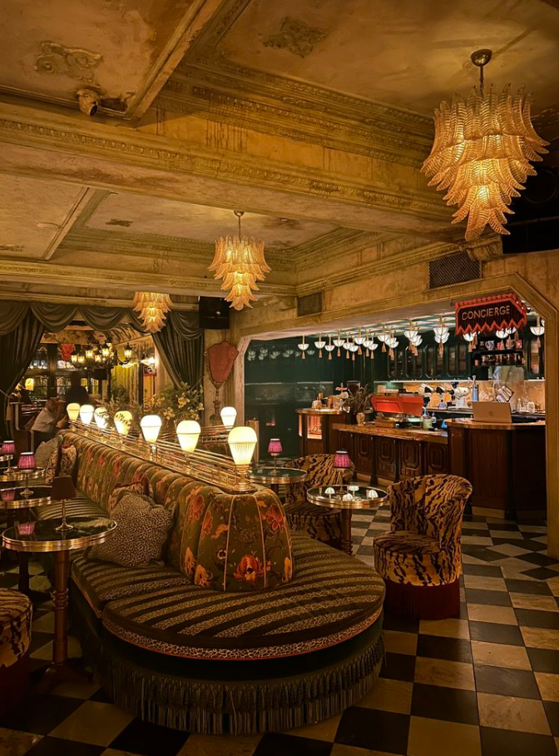
Introduction
Velvet Pour is a conceptual social lounge.
Designed exclusively for women.
Focused on celebration, and connection.

Slide 3
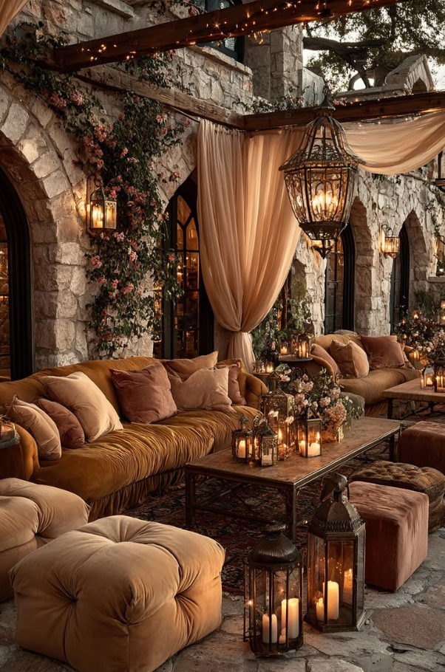
Reason for Choosing
Limited women-focused style spaces
Lack of social venues prioritizing safety
Few digital platforms for such concepts
Existing spaces often exclude comfort and control

Slide 4

Project Objective
Design a women-centered social venue
Develop a service-based e-commerce website
Provide online browsing, ordering & reservations

Slide 5
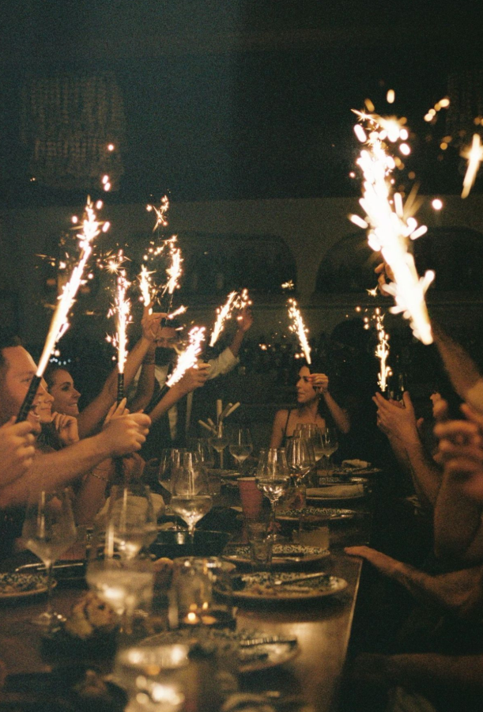
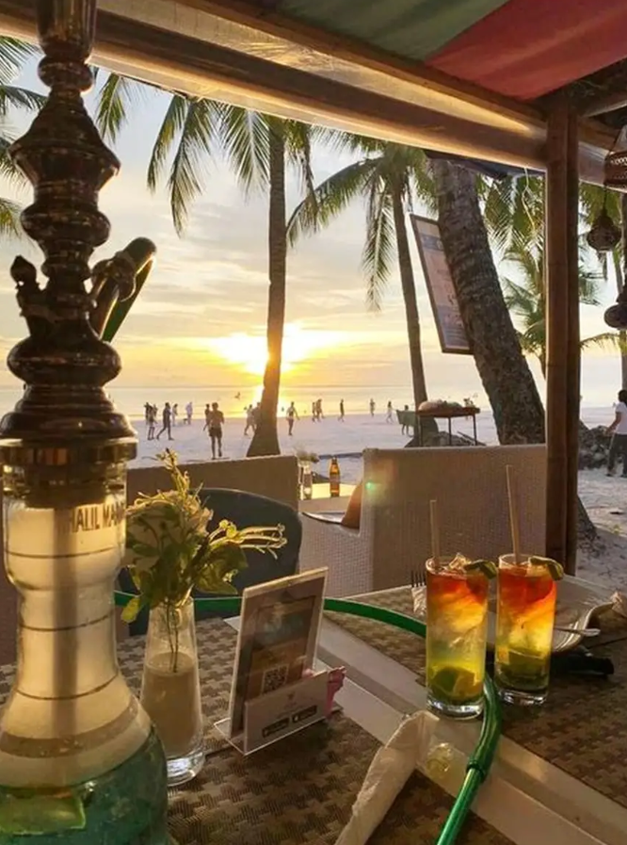
Concept & Inspiration
Energetic,
Celebratory environment
VIP-style ambiance
Space designed for connection and expression

Slide 6
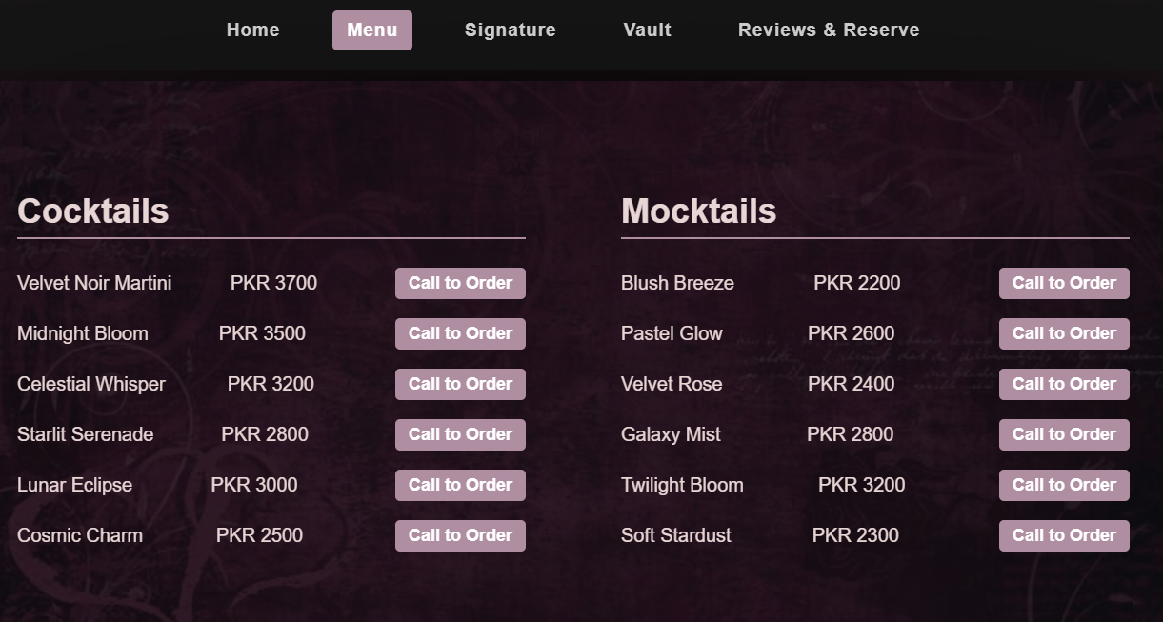
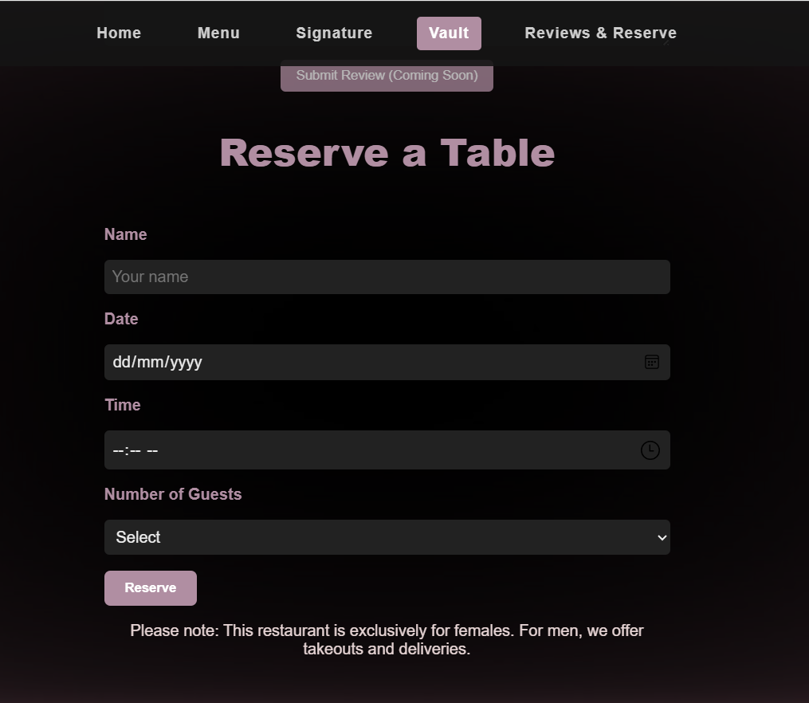
E-Commerce Features
Online product catalog (menu)
Visible pricing
Call-to-order integration
Digital reservations
Customer interaction features

Slide 7

Target Audience
People Looking for :
Socializing
Space
Unwinding
after a long week
VIP like Ambiance

Slide 8
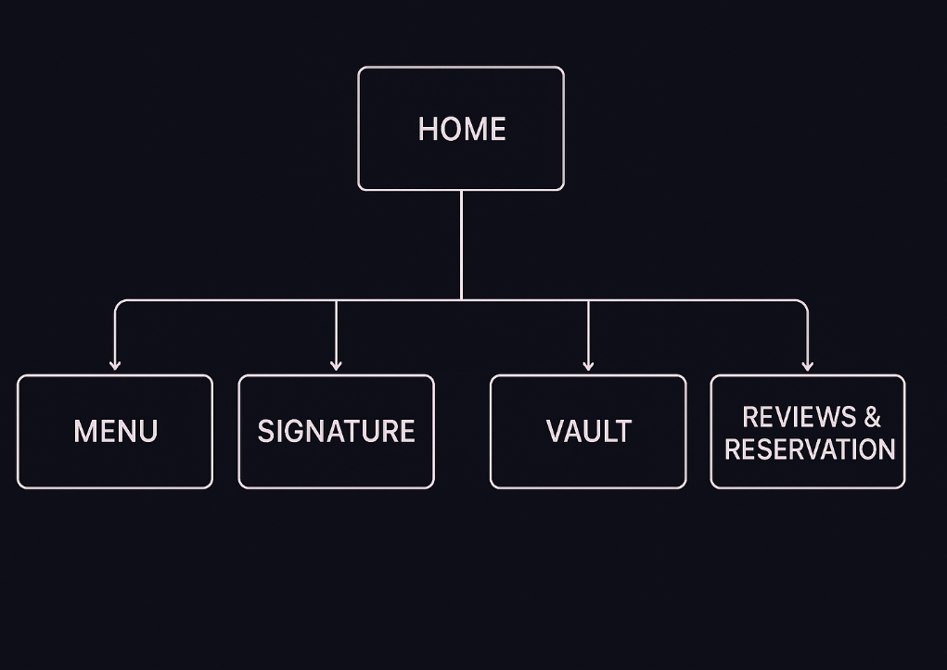
Website Structure
Home – Branding & tagline
Menu – Products & pricing
Signature – Featured product
Vault – Customer memory journal
Reviews & Reserve – Interaction & bookings

Slide 9
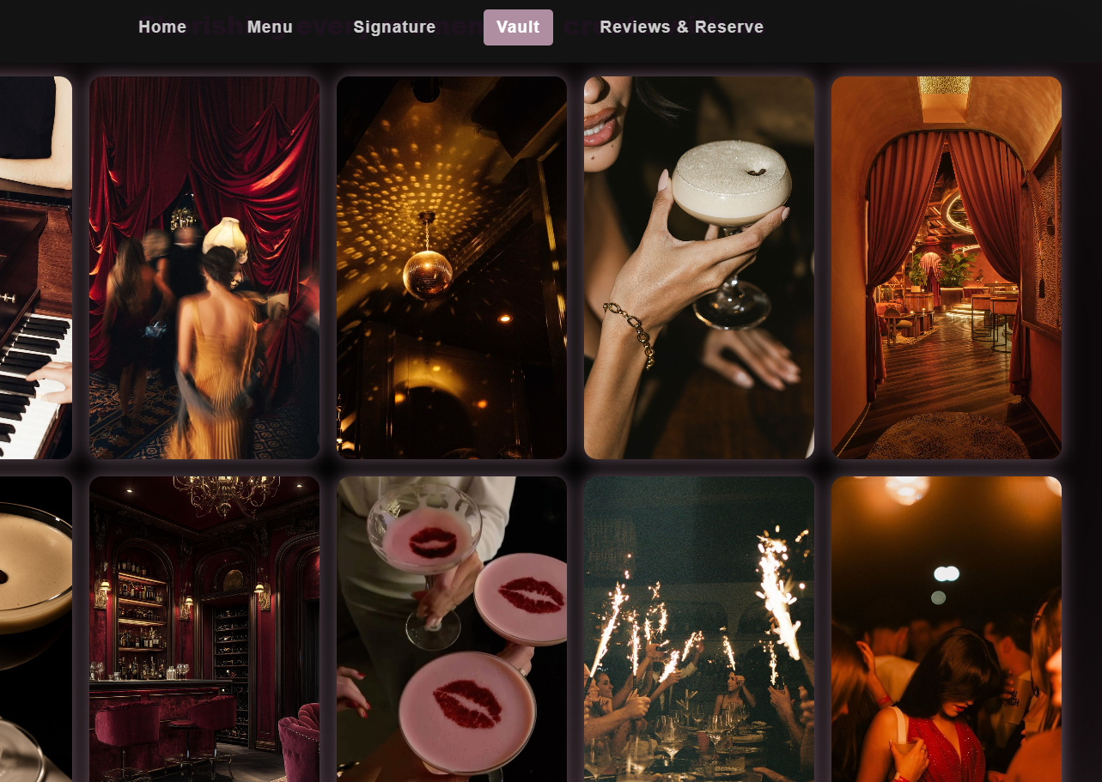
Vault – Memory Journal
Visual diary of customer moments
Strengthens emotional connection
Builds brand community
Encourages repeat engagement

Slide 10
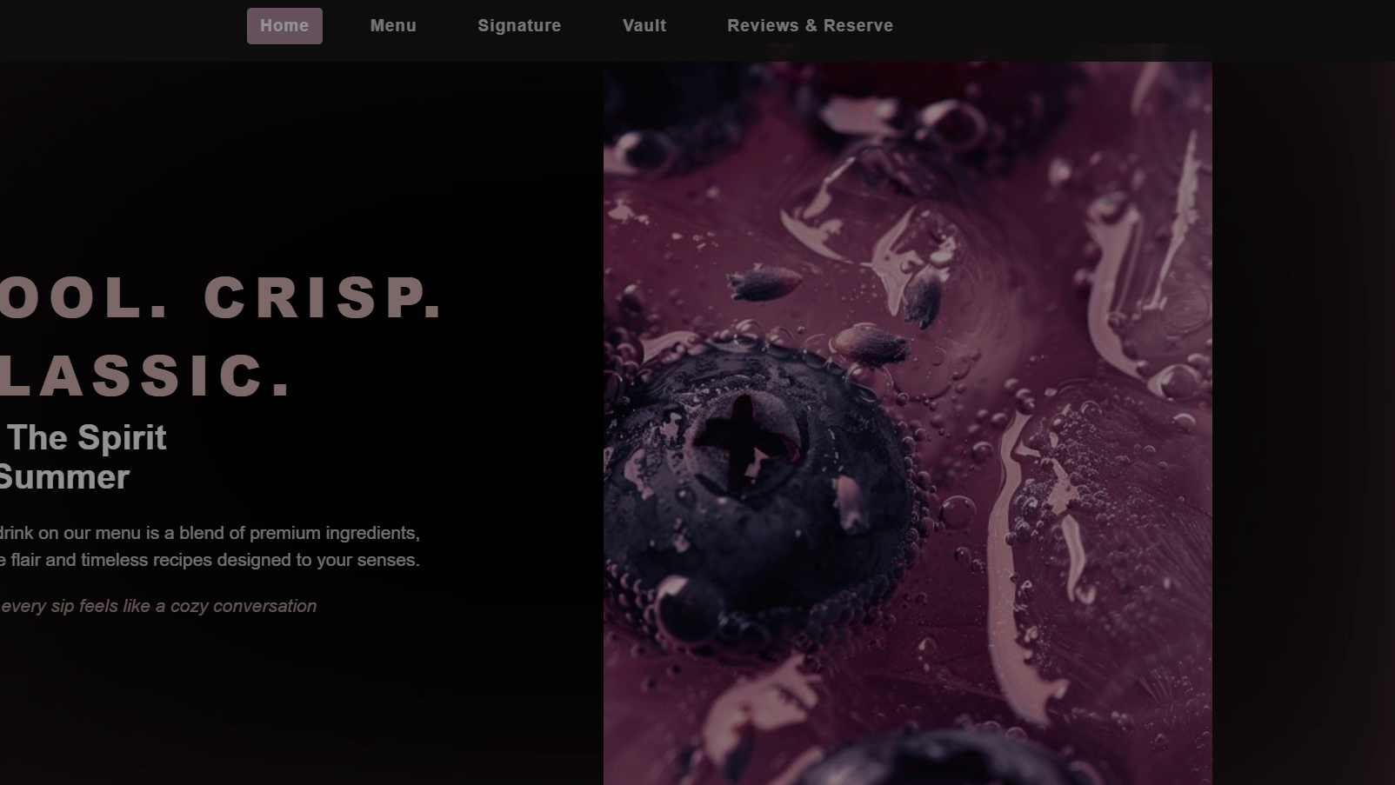
Visual Design Strategy
Dark theme for chic energetic look.
Accent colors for contrast
Strong typography
Clean spacing for usability

Slide 11
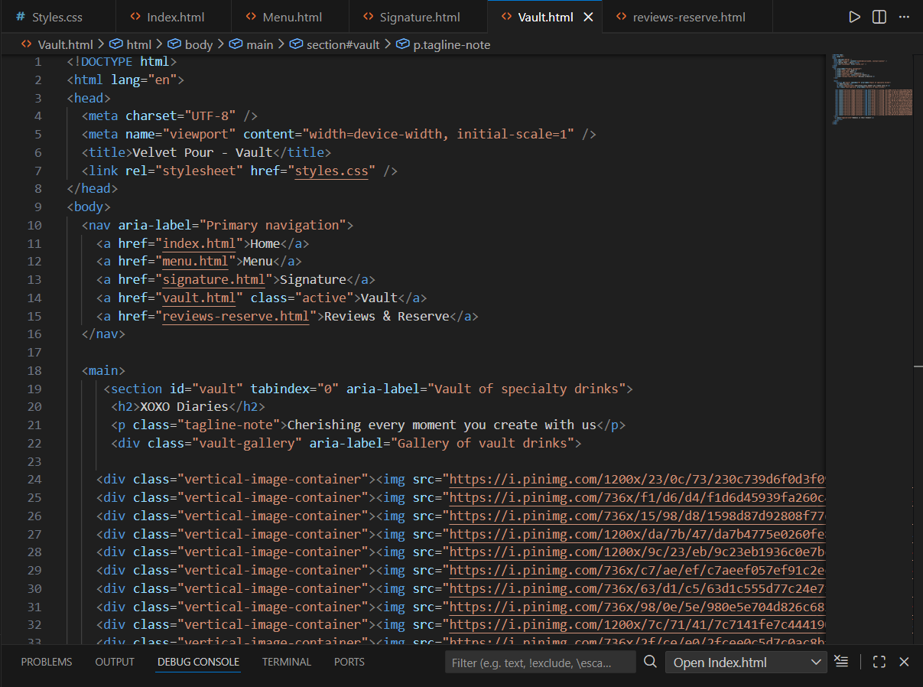
Technical Implementation
HTML5 for structure
CSS3 for styling
Multi-page architecture
External stylesheet
Beginner-friendly approach

Slide 12

Challenges Faced
Multi-page navigation
Layout alignment
Design consistency
Working without JavaScript

Slide 13

Solutions & Learnings
Used Flexbox & Grid
Modular CSS classes
Step-by-step testing
Improved code readability

Slide 14


Future Scope
Online checkout
Event bookings
User uploads for Vault
Mobile optimization

Slide 15
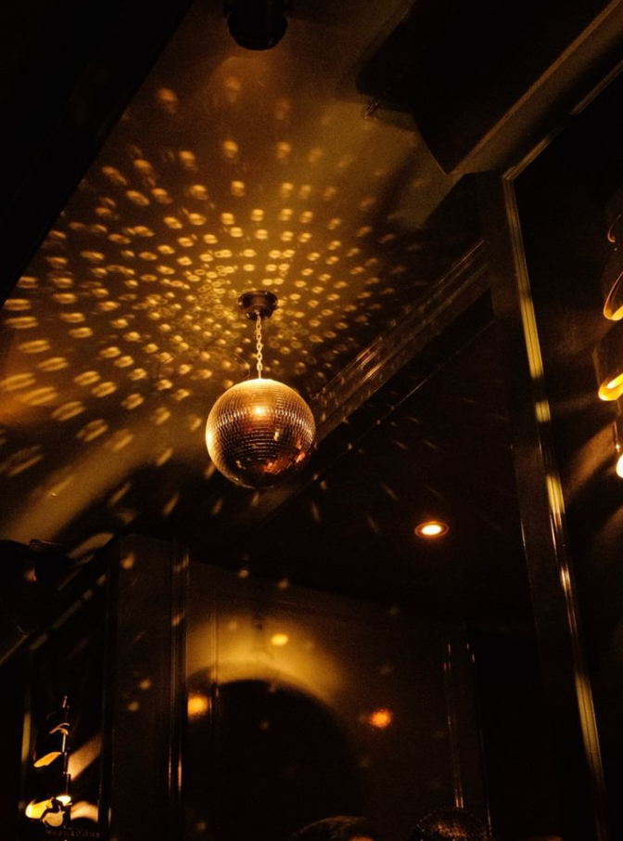
Conclusion
Combines social design and e-commerce
Focused on women-centered experiences
Strong beginner-level execution
Scalable digital concept

Slide 16

Thank You

